Slide 1

IST722 Data Warehousing
ETL Design and Development
Michael A. Fudge, Jr.

Slide 2
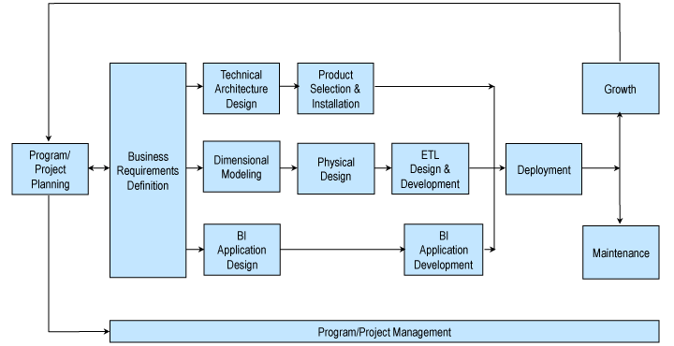
Recall: Kimball Lifecycle
Notes:
Describes an approach for data warehouse projects

Slide 3
Objective:
Outline ETL design and development process.
A “Recipe” for ETL

Slide 4
Before You Begin
Before you begin, you’ll need
Physical Design – Star Schema implementation in ROLAP, with initial load.
Architecture Plan – understanding of your DW/BI architecture.
Source to Target Mapping – Part of the detailed design process.

Slide 5
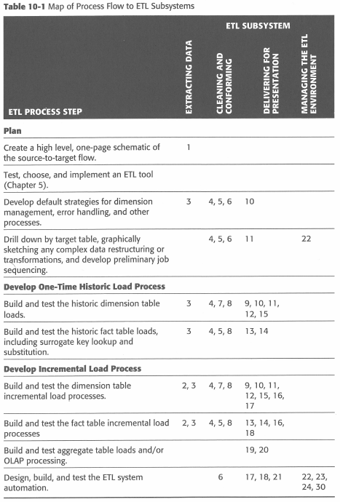
The Plan…
How the 34 subsystems map and are related to the 10 step plan.
According to Kimball.

Slide 6
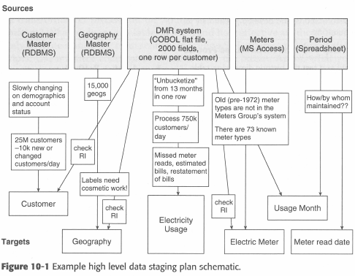
Step 1 – Draw The High Level Plan
This is called a source to target map.
Sources come from a variety of disparate areas.
Targets are Dimension and Fact Tables

Slide 7
Step 2 – Choose an ETL Tool
Your ETL tool is responsible for moving data from the various sources into the data warehouse.
Programming language vs. Graphical tool.
Programming ➔ Flexibility, Customizable
Graphical ➔ Self Documenting, Easy for beginners
The best solution is somewhere in the middle.

Slide 8
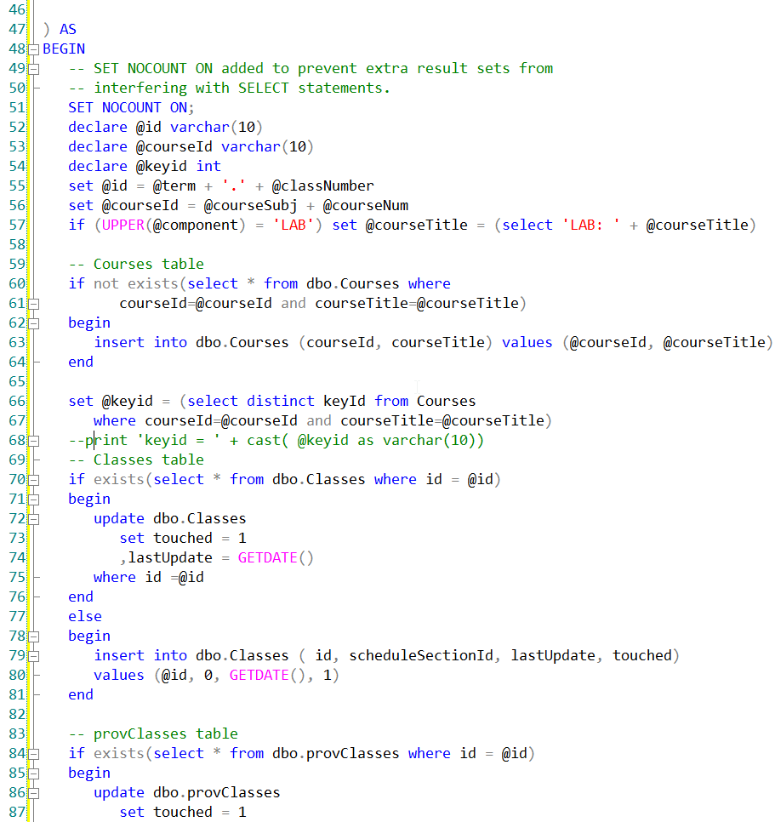
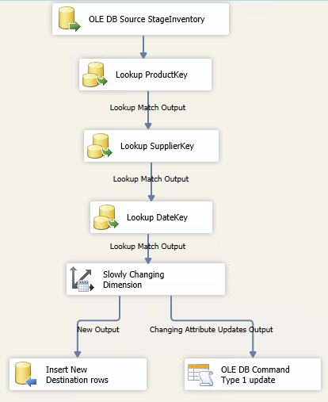
ETL: Code vs Tool
Which of these is easier to understand?

Slide 9
Step 3 – Develop Detailed Strategies
Data Extraction & Archival of Extracted Data
Data quality checks on dimensions & facts
Manage changes to dimensions
Ensure the DW and ETL meet systems availability requirements
Design a data auditing subsystem
Organize the staging data

Slide 10
The Role of the Staging
Staging stores copies of source extracts
This can be a Database or File Systems
Can create a history when none exists.
Reduces unnecessary processing of data source.
ETL: TRANSFORM (Tooling)
Data Sources
Staging File System or Database
Data Warehouse
EXTRACT
LOAD
ELT:TRANSFORM (SQL)

Slide 11
Step 4 – Drill Down by Target Table
Start drilling down into the detailed source to target flow for each target dimension and fact table
Flowcharts and pseudo code are useful for building out your transformation logic.
ETL Tools allow you to build and document the data flow at the same time:

Slide 12
Step 5 – Populate Dimensions w/ Historic Data
Part of the one-time historic processing step.
Start with the simplest dimension table (usually type 1 SCD’s)
Transformations
Combine from separate sources
Convert data ex. EBCDIC ←→ ASCII
Decode production codes ex. TTT→ Track-Type Tractor
Verify rollups ex: Category → Product
Ensure a “Natural” or “Business” key exists for SCD’s
Assign Surrogate Keys to Dimension table

Slide 13
Step 6 – Perform the Fact Table Historic Load
Part of the one-time historic processing step.
Transformations:
Replace special codes (eg. -1) with NULL on additive and semi- additive facts
Calculate and store complex derived facts ex: shipping amount is divided among the number of items on the order.
Pivot rows into columns ex: account type, amount → checking amount, savings amount
Associate with Audit Dimension
Lookup Dimension Keys using Natural/Business Keys….

Slide 14
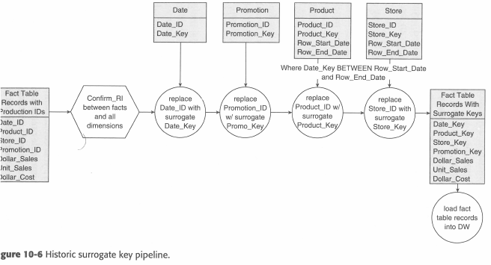
Example Surrogate Key Pipeline
Handles SCD’s

Slide 15
Step 7 – Dimension Table Incremental Processing
Oftentimes the same logic used in the Historic load can be used.
Identify New/ Changed data based on different attributes for the same natural key
ETL tools usually can assist with this logic.
CDC (Change Data Capture) Systems are popular

Slide 16
Step 8 – Fact Table Incremental Processing
A complex ETL:
Can be difficult to determine which facts need to be processed?
What happens to a fact when it is re-processed?
What if a dimension key lookup fails?
Some ETL tool assist with processing this logic.
Degenerate dimensions can be used ex: transaction number in order summary
A combination of dimension keys ex: StudentKey and ClassKey for grade processing.
CDC (Change Data Capture) Systems are popular

Slide 17
CDC Change Data Capture
Data Change Events (Create, Update, Delete) are passed to the CDC System
The system acts as a source for the ETL Process
OLTP
Database Transaction Log
CDC
System
ETL Job
OR
Msg Queue / Service Bus

Slide 18
Step 9 – Aggregate Table and OLAP Loads
Further processing beyond the ROLAP star schema.
Most ROLAPS Exist to feed the MOLAP Databases
Refresh / Reprocess
MOLAP cubes
INDEXED / MATERIALIZED views
Aggregate summary tables

Slide 19
Step 10 – ETL System Operation & Automation
Schedule jobs
Catch and Log errors / exceptions
Database management tasks:
Cleanup old data
Shrink Database
Rebuild indexes
Update Statistics

Slide 20
IST722 Data Warehousing
ETL Design and Development
Michael A. Fudge, Jr.

